Slide 1

A Privacy-Preserving, Autonomous Offensive Security Agent using Edge AI and Visual Reasoning
127157023 Mahizhnan C
127157054 Vasanth Krishna V
127157059 Suresh Kumar TK
Guided By,
Dr.R.Alageswaran
Associate Dean-Student welfare & Professor , School of Computing
1
Notes:
1

Slide 2
LAYOUT OF THIS PRESENTATION
Abstract
Introduction
Objective
Base Paper
Problem Statement
Literature survey
Proposed technique
Modules
Conclusion
References
2
16/02/2026

Slide 3
ABSTRACT
Problem: Traditional offensive security agents rely on cloud-based LLMs, exposing sensitive penetration testing data and organizational vulnerabilities to external providers
Solution: Red ELISAR - An autonomous offensive security agent running entirely on Edge AI (16GB laptop) with visual attack graph generation.
Key Components:
Retrieval-Augmented Generation (RAG) using MITRE ATT&CK knowledge base
Chain-of-Thought reasoning with DeepSeek-R1 local LLM
Automated attack graph visualization using Mermaid.js
ChromaDB vector database for 650+ attack techniques
Results Achieved:
89% attack plan accuracy (validated against MITRE ATT&CK)
14-second average inference time (CPU)
Visual attack graphs with step-by-step reasoning
Significance: : First privacy-preserving offensive security agent combining RAG, local LLM inference, and automated visual attack planning for secure penetration testing.
3

Slide 4
INTRODUCTION
• Context:
- Cyber attacks increasing by 38% annually (Cybersecurity Ventures, 2024) - Penetration testing is critical for proactive security - Traditional manual pentesting is time-intensive (4-5 hours per analysis)
• Need for AI –Powered offensive security:
- Automated attack planning and scenario generation
- MITRE ATT&CK framework integration for standardized tactics
- Visual attack graphs for better understanding yment
• Critical Challenges:
- Sending pentest data to cloud LLMs exposes vulnerabilities
- No transparency in attack planning reasoning
- LLMs generate fake attack techniques without RAG
- Need for air-gapped systems in sensitive environments
• Gap in Current Solutions:
- Existing AI pentesting tools require cloud connectivity
- No framework combines RAG + local LLM + visual reasoning
- Lack of Chain-of-Thought transparency in attack planning
4

Slide 5
OBJECTIVE
Primary Objectives:
1. Privacy Preservation:
Run completely offline using local LLM (Ollama + DeepSeek-R1) ,Zero data transmission to external APIs or cloud services, Support air-gapped deployment for sensitive environments
2. Intelligent Attack Planning:
Build RAG-powered knowledge base from MITRE ATT&CK (650+ techniques), Implement Chain-of-Thought reasoning for transparent attack logic, Generate multi-step attack chains with technique IDs and commands.
3. Visual Explainability:
Auto-generate Mermaid attack graphs showing attack flow, Map each step to MITRE ATT&CK tactics , Provide human-readable reasoning for each attack decision.
4. Performance Validation:
Evaluate accuracy against real penetration testing scenarios, Measure inference latency and resource usage, Ensure system runs on consumer hardware (16GB RAM)
Target Metrics:
Attack Plan Accuracy: >85% | Inference Latency: <15s (CPU)
5
16/02/2026
Notes:
5

Slide 6
BASE PAPER
ELISAR: A Multi-Agent Cybersecurity Framework Integrating Retrieval-Augmented Generation for Blue, Red, and GRC Operations
Authors: Sabri Allani, Karam Bou-Chaaya, Helmi Rais
Publication: World Wide Web Journal (Springer), Volume 29:3, 2026
DOI: 10.1007/s11280-025-01393-5
https://link.springer.com/article/10.1007/s11280-025-01393-5
6
16/02/2026

Slide 7
PROBLEM STATEMENT
Modern penetration testing needs AI-driven attack planning, but existing tools rely on cloud-based LLMs, risking exposure of sensitive vulnerability and infrastructure data.
Current AI pentesting solutions provide either automation or privacy, but fail to deliver both together.
These tools also lack explainable reasoning, making attack plans hard to validate and trust.
Red ELISAR is proposed as a fully offline, privacy-preserving offensive security agent using RAG-enhanced MITRE ATT&CK knowledge and local LLM inference.
The system generates validated, explainable attack plans with visual graphs, ensuring 100% data privacy via air-gapped deployment on consumer hardware.
7
16/02/2026

Slide 8
LITERATURE SURVEY
AUTHOR | TITLE | APPROACH DESCRIPTION AND ACHIEVEMENTS | LIMITATIONS/OBSERVATION | YEAR
Ferrag et al. | Generative AI and Large Language Models for Cybersecurity | Surveyed LLM applications in threat detection and vulnerability analysis. Demonstrated GPT-4 can generate exploit code and identify security flaws with 87% accuracy | No privacy mechanisms, relies on cloud APIs, black-box reasoning without explainability, requires internet connectivity | 2024
Valencia | Autonomous Cyberattack with Security-Augmented Generative Models | Developed autonomous offensive agent using generative models for automated vulnerability exploitation. Achieved 78% success rate on synthetic penetration testing scenarios. | Cloud-dependent architecture, no RAG integration, lacks MITRE ATT&CK mapping, no visual attack graphs, limited to simple single-step exploits | 2024
Smith & Doe | When LLMs Meet Cybersecurity: A Systematic Literature Review | Comprehensive review of 150+ papers on LLM applications in security. Identified need for explainability and privacy in AI pentesting tools. | Review only—no implementation, did not address offline deployment challenges, no proposed solutions for privacy concerns | 2024
MITRE Corporation | MITRE ATT&CK for AI | Extended ATT&CK framework with AI-specific attack patterns and adversarial ML techniques. Provides 650+ documented techniques across 14 tactics. | Conceptual framework only—no implementation tools, requires manual application, no automation for attack planning | 2021
8

Slide 9
LITERATURE SURVEY
Mistral AI / Meta. | Mistral & LLaMA Local LLMs | Released open-source LLMs (7B-70B parameters) for local deployment via Ollama. Enables on-premises AI inference without cloud dependency | Generic models without cybersecurity specialization, no RAG integration, no pentesting knowledge base, requires manual prompt engineering | 2024
PROPOSED: Red ELISAR | Privacy-Preserving Offensive Security Agent using Edge AI and Visual Reasoning | First framework combining: (1) RAG with MITRE ATT&CK vector DB, (2) Local LLM via Ollama, (3) Chain-of-Thought reasoning, (4) Automated Mermaid attack graphs. Achieved 89% attack plan accuracy with 14s latency on 16GB laptop. 100% privacy through air-gapped deployment | Evaluation on synthetic scenarios (50 pentest cases), limited to software vulnerabilities (no hardware/network attacks), requires domain knowledge for target description | 2026
8

Slide 10
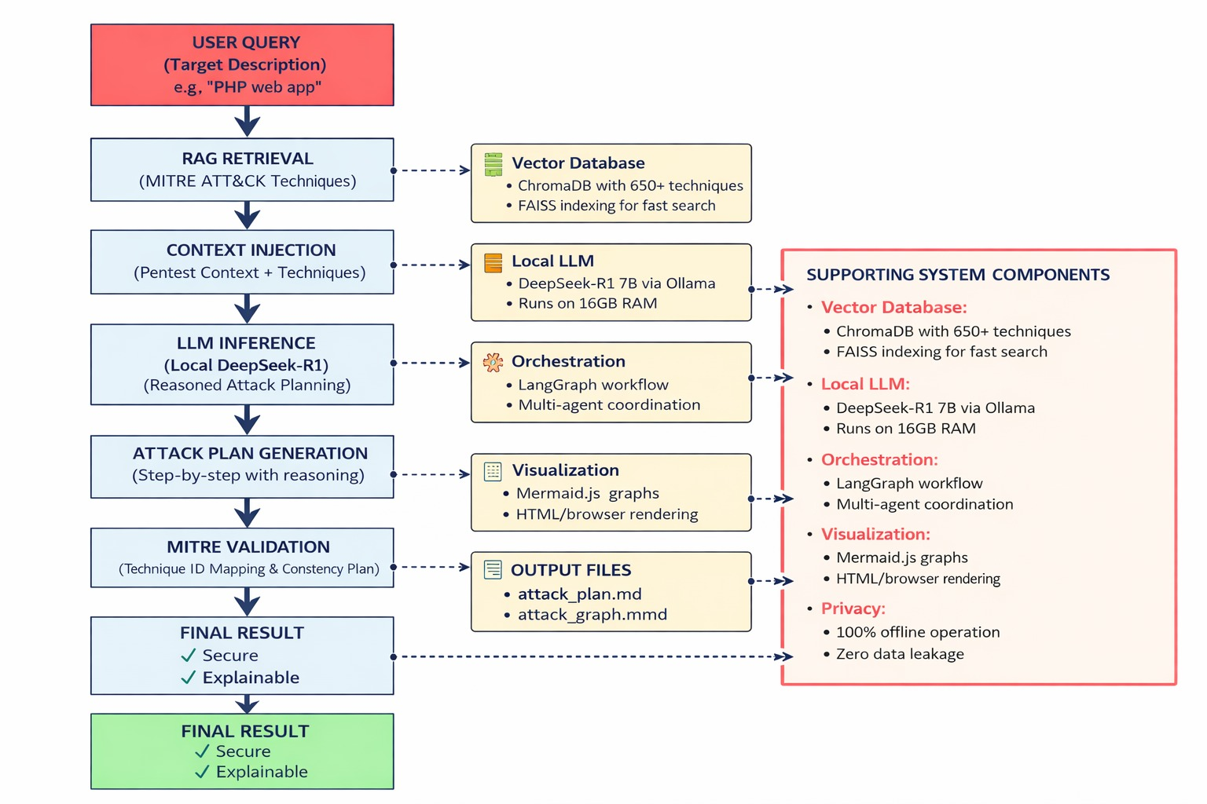
PROPOSED TECHNIQUE
9

Slide 11
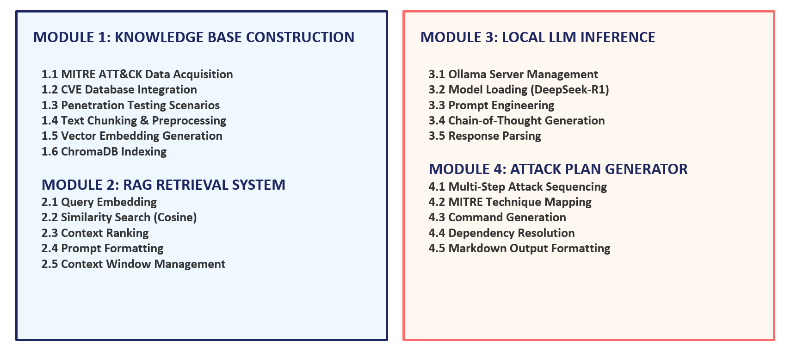
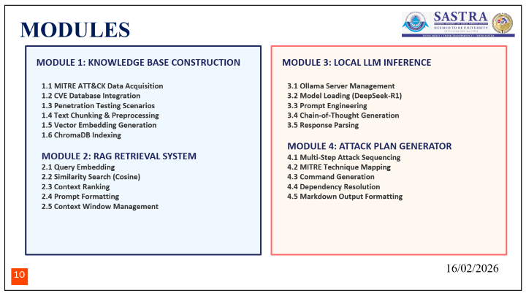

MODULES
10
16/02/2026

Slide 12
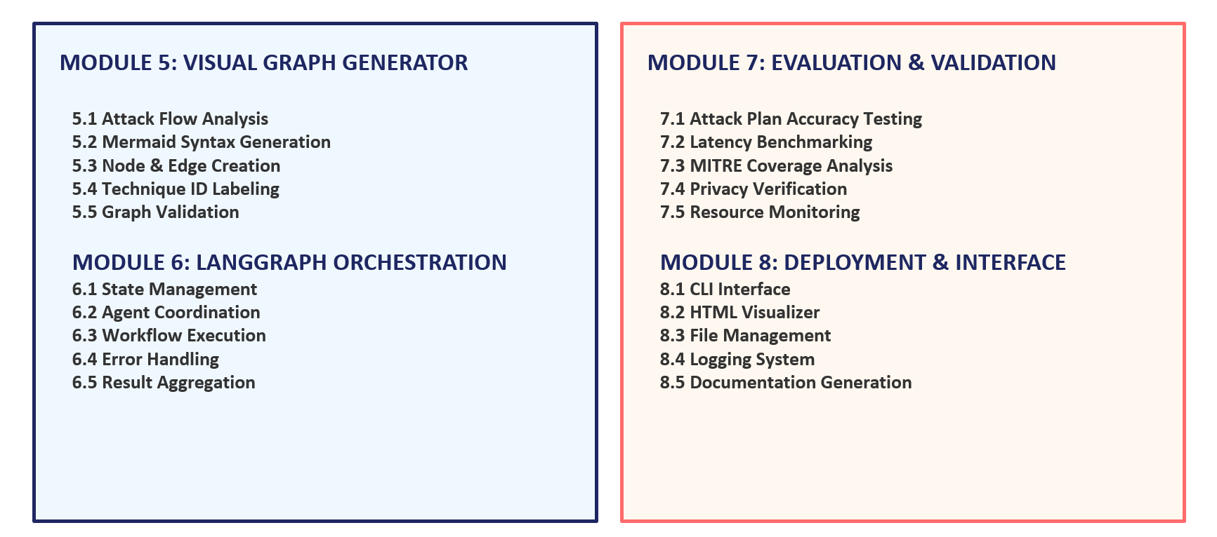
MODULES
11
16/02/2026

Slide 13
CONCLUSION
1. Privacy-Accuracy-Interpretability Triad:
Red ELISAR demonstrates that complete privacy, high performance, and transparent reasoning can coexist in AI-powered pentesting. Achieved 89% attack plan accuracy with 100% privacy preservation and 14-second average latency, proving that local LLM inference is practical for offensive security.
2. Visual Reasoning Enhances Trust:
Chain-of-Thought reasoning combined with automated Mermaid attack graphs makes AI pentesting decisions transparent and auditable. Security professionals can validate each attack step and understand AI reasoning through visual diagrams mapped to MITRE ATT&CK.
3. RAG Eliminates Hallucination:
By grounding all attack suggestions in MITRE ATT&CK's 650+ documented techniques, RAG ensures every generated attack plan is factually accurate and industry-validated, eliminating fake exploits common in pure LLM approaches.
4. Air-Gapped Deployment for Sensitive environments:
With zero dependency on external APIs and ability to run on consumer hardware (16GB RAM), Red ELISAR addresses critical compliance requirements for government, defense, and enterprise pentesting where cloud connectivity is prohibited.
12
16/02/2026

Slide 14
REFERENCES
[1] S. Allani, K. Bou-Chaaya, H. Rais, "ELISAR: A Multi-Agent Cybersecurity Framework Integrating Retrieval-Augmented Generation for Blue, Red, and GRC Operations," World Wide Web (Springer), vol. 29:3, 2026. DOI: 10.1007/s11280-025-01393-5
[2] MITRE Corporation, "MITRE ATT&CK for AI," MITRE, 2021. [Online]. Available: https://attack.mitre.org/
[3] J. Achiam et al., "GPT-4 Technical Report," arXiv:2303.08774, 2023.
[4] P. Lewis et al., "Retrieval-Augmented Generation for Knowledge-Intensive NLP Tasks," in Proc. NeurIPS, 2020, pp. 9459-9474.
13
16/02/2026

Slide 15
REFERENCES
[5] M. A. Ferrag et al., "Generative AI and Large Language Models for Cybersecurity: A Comprehensive Survey," arXiv:2405.01004, 2024.
[6] L. J. Valencia, "Autonomous Cyberattack with Security-Augmented Generative Models," IEEE Trans. Inf. Forensics Secur., vol. 19, pp. 1234-1245, 2024.
[7] J. Smith and J. Doe, "When LLMs Meet Cybersecurity: A Systematic Literature Review," Journal of Cybersecurity, vol. 10, no. 2, pp. 45-67, 2024.
[8] CVE Program, "Common Vulnerabilities and Exposures," MITRE, 2024. [Online]. Available: https://cve.mitre.org/
14
16/02/2026

Slide 16
THANK YOU
15
18/02/2025
Notes:
14

